Slide 1

Building Rich Web Applications with Blazor Server and MudBlazor
Flora Mousavi
IT Developer at JSG
Microsoft .NET Conf 2024 | November 14, 2024

Slide 2
Section 1: Blazor Server & MudBlazor Overview
Section 2: Blazor Server Core Concepts & Implementation
Section 3: MudBlazor Components and Features
Agenda
Section 4: Setup MudBlazor in Blazor Server
Section 5: Application of MudBlazor in a Real-World Scenarios
Q&A

Slide 3
Section 1 Blazor Server & MudBlazor Overview

Slide 4
Introduction to Blazor Server

Slide 5
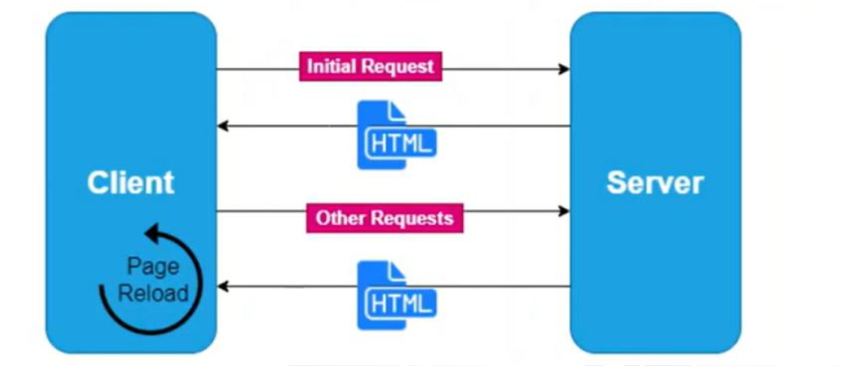
Traditional Web Application Architecture

Slide 6
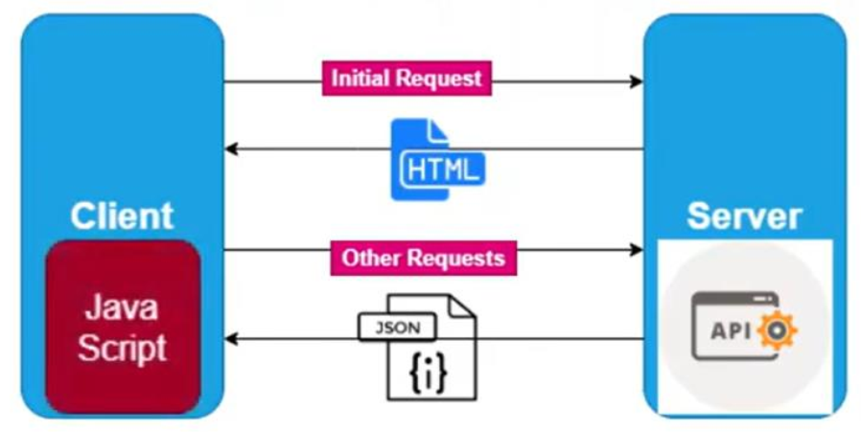
Single Page Web Application Architecture

Slide 7
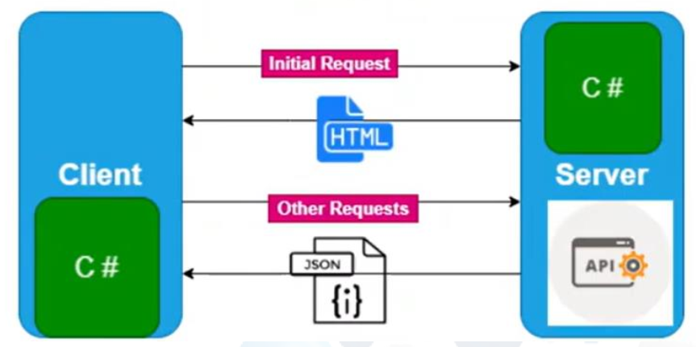
Blazor Client Web Application Architecture

Slide 8
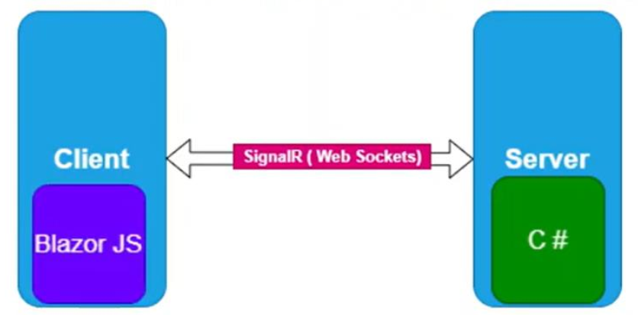
Blazor Server Web Application Architecture

Slide 9
Blazor Timeline
.Net 8
.Net 6
Unified Blazor Server and WebAssembly (Blazor United).
Enhanced performance, authentication, and file uploads.
Deeper .NET MAUI integration for cross-platform apps.
.Net 3.1
New templates and Hot Reload.
Introduced AOT for WebAssembly.
Added error boundaries and React/Angular support.
Integrated Blazor into .NET Core.
Supported component sharing.
Aligned with .NET Standard.
2018
2020
2022
2019
2021
2023
Preview
.Net 5
.Net 7
Introduced WebAssembly and Blazor Server.
Enabled Single-Page Apps (SPA) with C#.
Added initial Visual Studio support.
Added CSS isolation for components.
Enhanced performance with virtualization.
Improved WebAssembly size and added lazy loading.
Enhanced Hot Reload and .NET MAUI integration.
Improved debugging with new console output.
Allowed custom validation service injection.

Slide 10

What is Blazor Server?
A .NET-based framework for building interactive web applications with C#, running on the server.
Blazor Server relies on real-time communication with the client using SignalR, allowing it to provide rich, dynamic UIs without JavaScript.
It keeps complex logic on the server, reducing client-side resource demands.
It manages per-user state on the server, making it suitable for applications with sensitive data.
It allows for responsive UIs by pushing updates to the client over WebSockets.

Slide 11
Introduction to MudBlazor

Slide 12

What is MudBlazor?
A Material Design component library for Blazor.
Simplifies web development without needing CSS or JavaScript.
Built to work seamlessly with C# for Blazor applications.
Key Features of MudBlazor
Offers components like date pickers, tables, and progress bars.
Uses C# for almost all components, minimizing JavaScript.
Responsive and customizable for modern web interfaces.

Slide 13
Why MudBlazor?
Intuitive, beginner-friendly API that’s also efficient for experienced developers.
Quick to get started; ideal for building sophisticated web applications rapidly.
Optimized for fast loading and smooth user experience, even on low-end devices.
Leverages modern web technologies for high performance across platforms.
Flexible components easily customized to fit your app’s design.
Offers a complete set of components, from simple buttons to complex data grids and charts.

Slide 14
Explore MudBlazor in Action: https://try.mudblazor.com/
Live Demos: Try pre-built components like buttons, tables, and forms.
Customize in Browser: Edit code and test themes and layouts instantly.
No Setup Needed: Start experimenting right away.
Responsive View: See how components adapt to different screen sizes.
Hands-On Learning: Perfect for all skill levels to explore and learn MudBlazor.

Slide 15
Section 2 Blazor Server Core Concepts & Implementation

Slide 16
Key Concepts In Blazor Server Development

Slide 17
Core Concepts for Building with Blazor Server
Real-Time Interactivity: Achieve responsive user interfaces by leveraging server-side processing and SignalR for instant UI updates.
Centralized Logic and Security: Keep complex logic on the server, enhancing security by minimizing client-side data exposure.
Scoped State Management: Maintain user-specific state across sessions using scoped services for a consistent, personalized experience.
Efficient Server-Client Communication: Use WebSocket connections (via SignalR) to streamline data exchanges between client and server for low latency..

Slide 18
Essential Configuration for Blazor Server

Slide 19
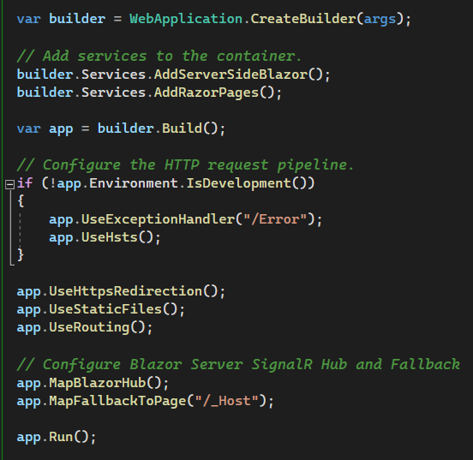
Blazor Server Implementation Essentials
Register Blazor Services
AddServerSideBlazor() registers essential services, including SignalR for real-time updates.
Routing Setup
MapBlazorHub(): Sets up SignalR for client-server communication.
MapFallbackToPage("/_Host"): Defines the Blazor app's main entry point for seamless navigation.

Slide 20
Section 3 MudBlazor Components and Features

Slide 21
MudBlazor Components
MudBlazor offers a wide range of UI components like buttons, forms, tables, and cards, all styled with Material Design.
Each component is highly customizable and can be tailored to fit various use cases in Blazor applications.
Built-in components make it easy to create consistent and responsive UIs without external CSS or JavaScript.
Accessibility Focus: MudBlazor components are designed with accessibility in mind, ensuring compliance with modern accessibility standards for inclusive user experiences.

Slide 22
MudBlazor Features
Material Design: Modern, visually appealing components that follow Material Design principles.
Custom Themes: Easily adjust colors, typography, and styles to fit your brand.
Responsive: Built-in grid system and adaptable components for all screen sizes.
Icons: Pre-integrated Material Icons for quick and easy use.
Advanced Components: Includes MudTable, MudDialog, MudChart, and more for complex UIs.
Accessible: Meets accessibility standards for inclusive web applications.
C#-Only: No JavaScript needed; fully functional with C# and Razor.

Slide 23
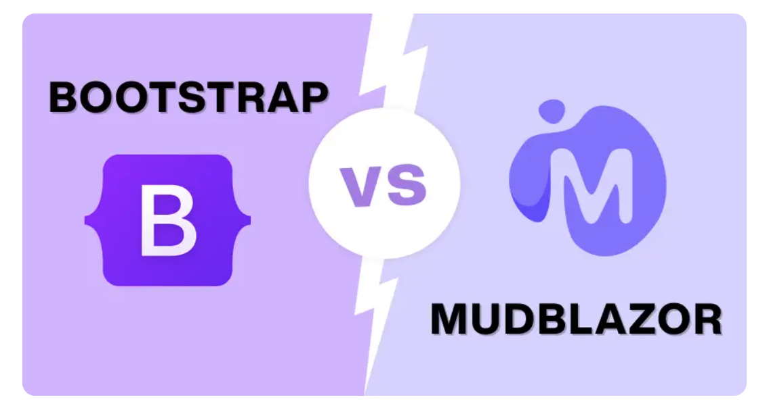

Slide 24
MudBlazor uses C# and Razor, fully integrated with Blazor, no need for HTML/CSS/JS.
Bootstrap requires HTML, CSS, and JavaScript, making it less seamless in Blazor.
Blazor Integration
MudBlazor enables dynamic, reusable components in C# and Razor.
Bootstrap may need custom JavaScript for component interactivity.
Code-Based Components
MudBlazor is lightweight and optimized for Blazor, enhancing .NET app performance.
Bootstrap adds overhead and may slow down Blazor projects.
Performance
Customization &
Flexibility
MudBlazor offers deep customization for .NET developers.
Bootstrap has many components but often requires extra styling in Blazor.

Slide 25
Section 4 MudBlazor Setup in Blazor Server Building Rich Web Apps

Slide 26
Steps to start Mudblazor in Blazor Server Application

Slide 27
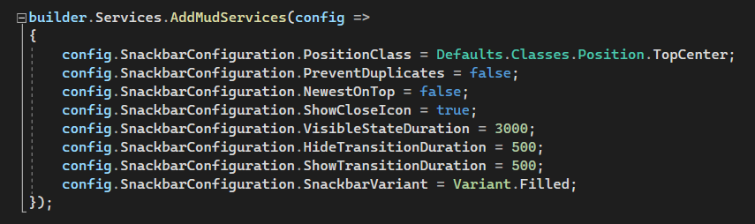
Installing MudBlazor
Step 1
Install MudBlazor via NuGet
dotnet add package MudBlazor
Step 2
Configure Services in Program.cs

Slide 28
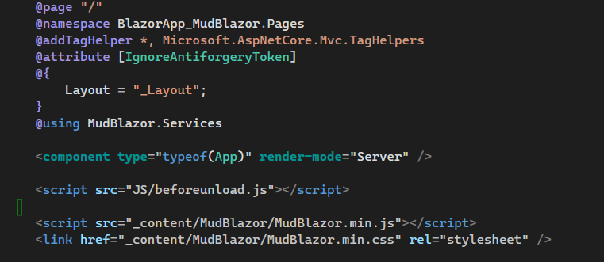
Step 3
Add MudBlazor CSS and JS in _Host.cshtml

Slide 29
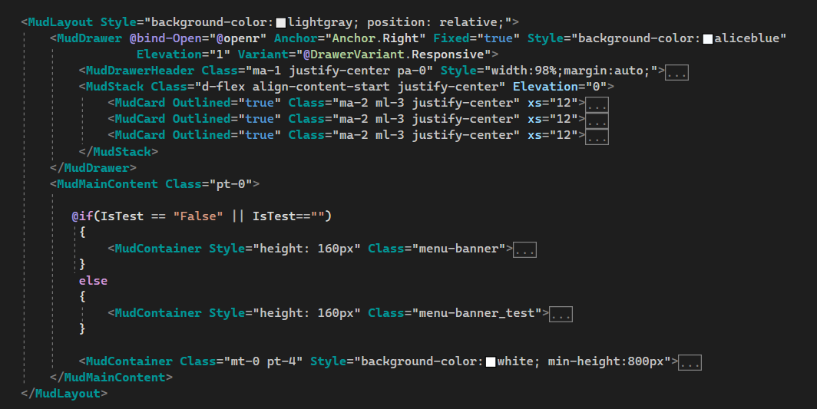
Step 4
Setting Up a Basic MudBlazor Layout(MainLayout.razor)

Slide 30
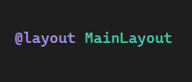
Step 5
Add the layout directive to set MainLayout as the default layout for all components:

Slide 31
Section 5 Application of MudBlazor in a Real-World Scenarios

Slide 32
Real-World Project Demo

Slide 33
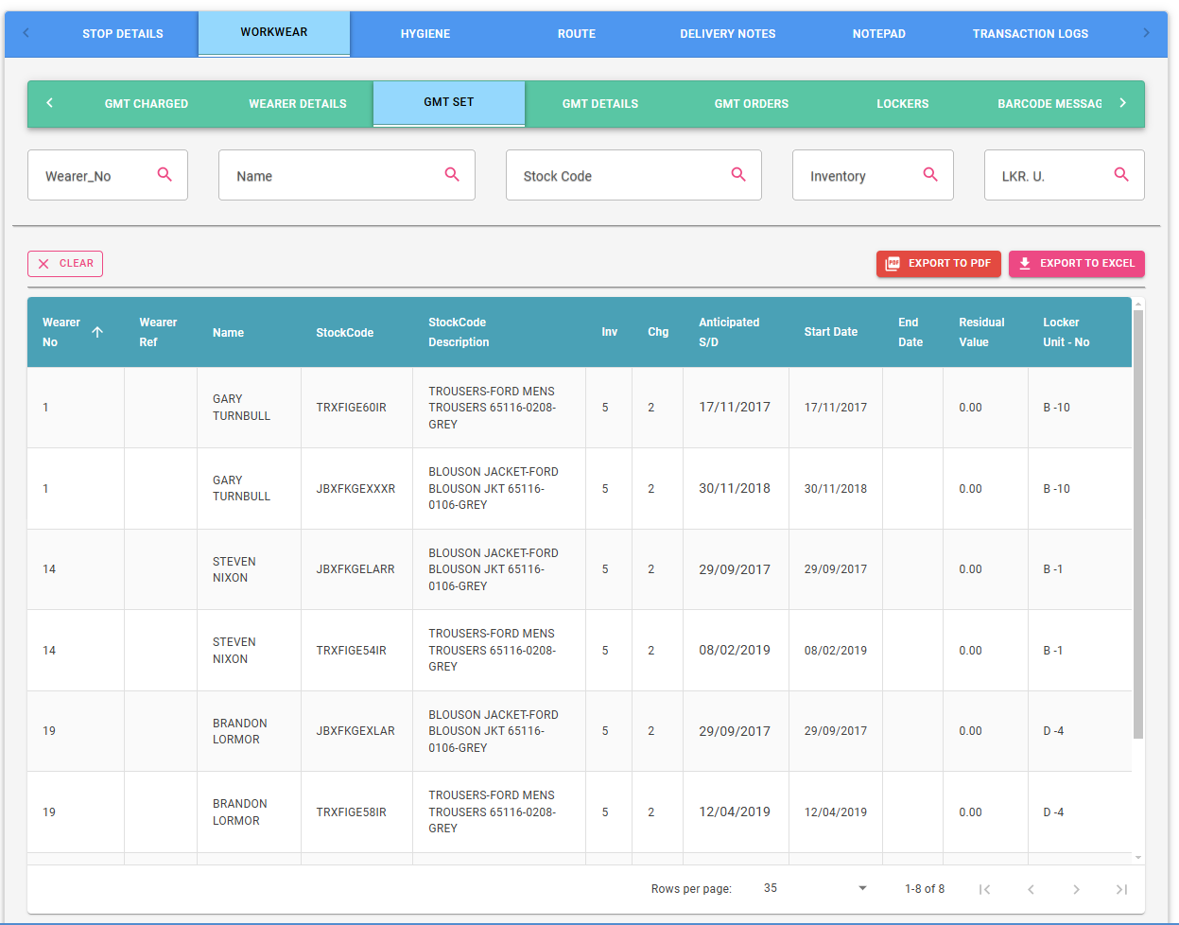

Slide 34
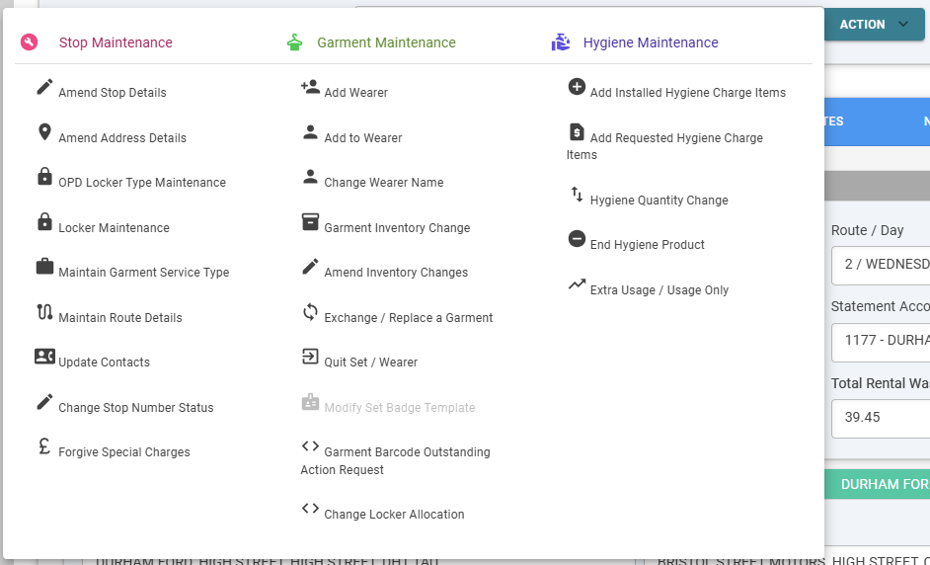

Slide 35
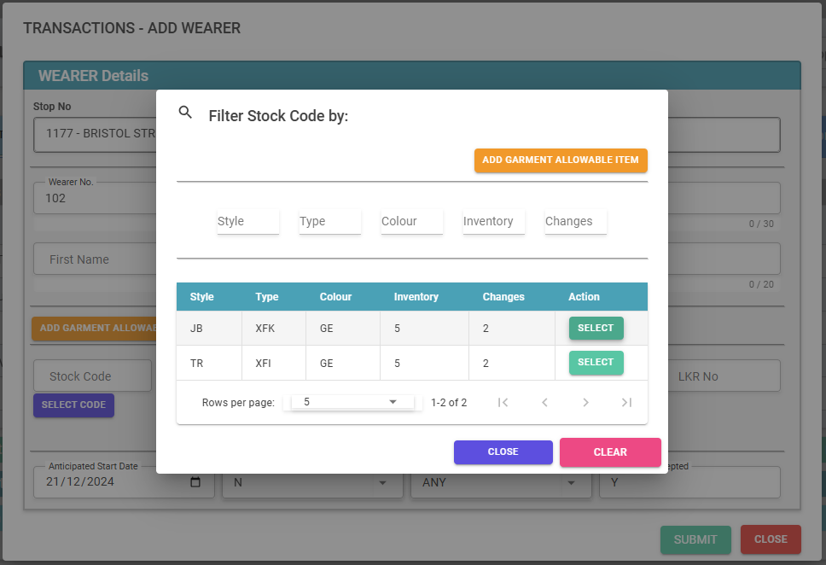

Slide 36
Thank you

